Slide 1
Image Partitioning for Compact Encoding
Group - 4
Hetvi Shah(AU2340101) Twisha Patel(AU2340056)
Manushree Patel(AU2340014) Sanya Shah(AU2340259)

Slide 2
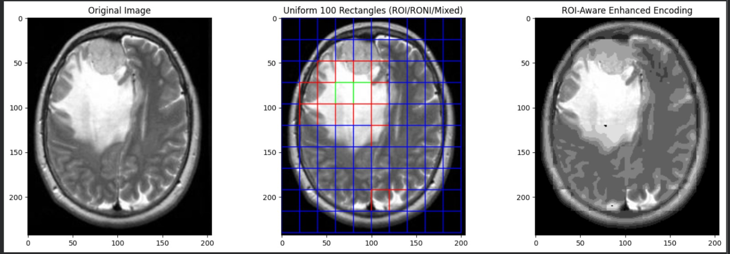
WORK BEFORE MIDSEM
ROI-Based Compression
Detect ROI & divide image into blocks
Classify blocks: ROI(Sharpen) / RONI(Strong lossy compression) / Mixed (Wavelet enhancement)
Sharpen ROI, compress RONI
Enhance mixed blocks using wavelets
Result: ROI clear, size reduced
https://www.kaggle.com/navoneel/brain-mri-images-for-brain-tumor-detection

Slide 3
LITERATURE REVIEW
Method | Domain/Technique | Strengths | Limitations/Gaps
JPEG/JPEG-LS | Spatial, predictive & entropy coding | Simple, lossless compression | Treats all regions equally; ROI not prioritized
Block-based PCA | Statistical feature reduction | Reduces redundancy in local blocks | Ignores spatial–frequency variations; ROI edges blurred
JPEG 2000 (Wavelet ROI Coding) | Wavelet transform with Maxshift ROI | Multiresolution, better ROI preservation | Mixed blocks cause ROI boundary distortion
Proposed Method (Rectangular Partition + Wavelet/ Inverse Wavelet) | Hybrid spatial–frequency approach | ROI enhanced, Non-ROI blurred; mixed regions refined | More computation, but highest diagnostic fidelity
Segmentation-Guided ROI | DL masks (MediaPipe), thresholding | Automatic ROI; real-time; edge-device friendly | Runtime cost; model dependence
https://doi.org/10.3390/s24030791](https://doi.org/10.3390/s24030791
https://doi.org/10.1109/ICOSP.2010.5655736
https://www.ias.ac.in/public/Volumes/sadh/038/01/0123-0131
https://doi.org/10.1109/ICCPEIC.2016.7557289

Slide 4
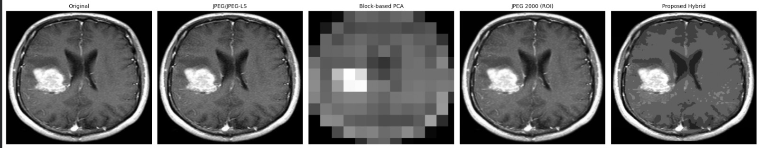
https://www.kaggle.com/navoneel/brain-mri-images-for-brain-tumor-detection
Metric | JPEG / JPEG-LS | Block-based PCA | JPEG 2000 (ROI) | Proposed Hybrid
File Size (KB) | 14.12 | 2.35 | 12.98 | 12.47
Global PSNR | 39.1634 | 14.6744 | 35.5782 | 29.4440
Global SSIM | 0.9520 | 0.4198 | 0.9867 | 0.8223
ROI PSNR | 37.0445 | 7.5078 | 32.6101 | 34.7212
ROI SSIM | 0.9520 | 0.4198 | 0.9867 | 0.8223
HQI | 0.9502 | 0.4474 | 0.9657 | 0.9294

Slide 5
UPDATED METHODOLOGY
ROI mask: MediaPipe person segmentation
Block split: Compute ROI ratio per block (r)
Classify blocks: ROI (r ≥ 0.80) / Mixed (0.01< r <0.80) / RONI (r≤0.01)
Process:
- ROI → sharpen
- Mixed → mild enhance
- RONI → strong blur + quantize
- Recombine blocks
- Final step: Low-quality JPEG for max compression

Slide 6
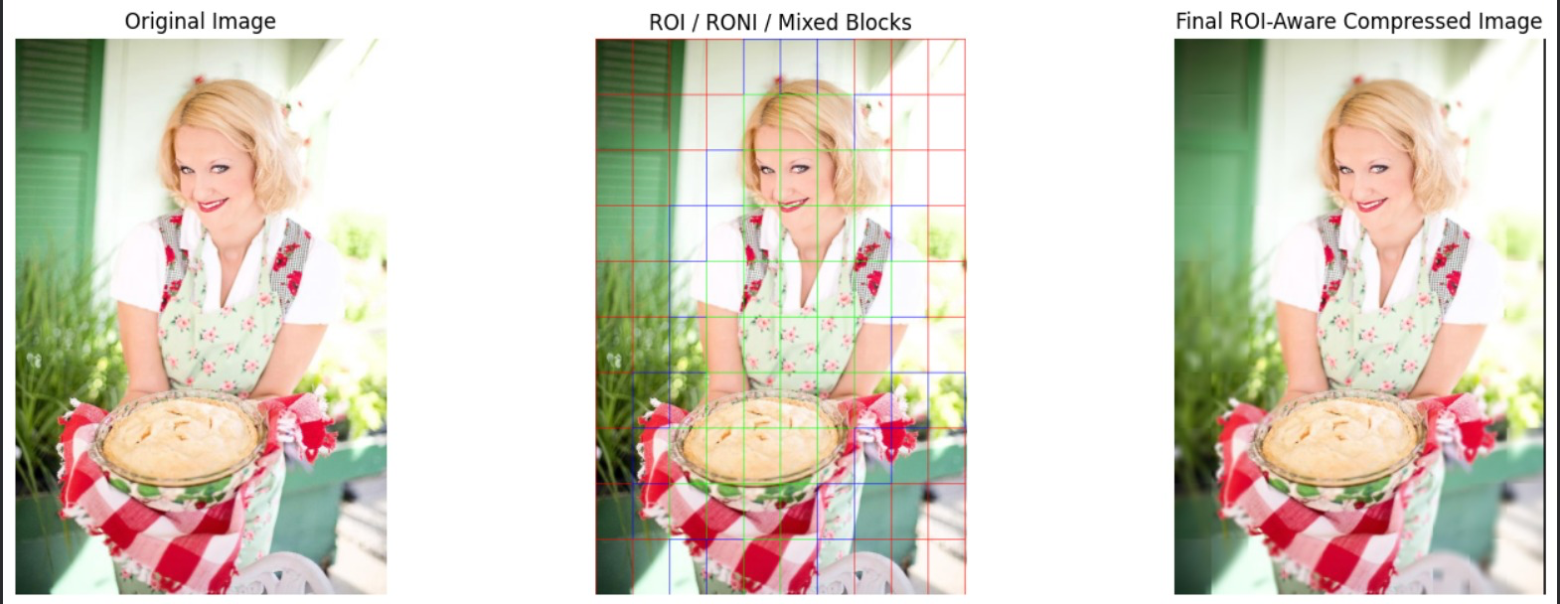
RESULTS
ROI Blocks (Green): Apply sharpening
RONI Blocks (Blue): Apply strong lossy compression
Mixed Blocks (Red): Apply wavelet-based enhancement
https://www.kaggle.com/datasets/nikhilroxtomar/person-segmentation

Slide 7
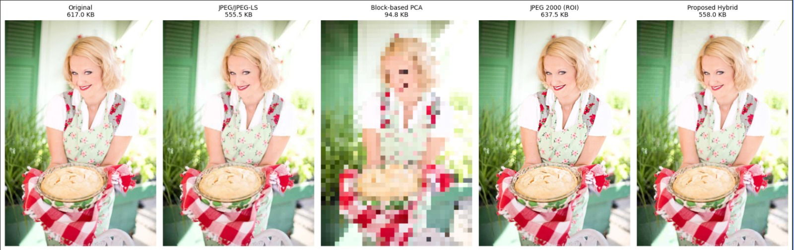
https://www.kaggle.com/datasets/nikhilroxtomar/person-segmentation
Original | JPEG / JPEG-LS | Block-based PCA | JPEG 2000 (ROI) | Proposed Hybrid
617.0 KB | 555.5 KB | 94.8 KB | 637.5 KB | 558.0 KB

Slide 8
CONCLUSION
ROI keeps key areas sharp, compresses background.
Hybrid method works best for medical images.
In RGB images, JPEG2000 performs better than our hybrid method.
Overall: clearer ROIs, smaller size for non-ROI, better efficiency.

Slide 9
REFERENCES
Ungureanu, V.-I., Negirla, P., & Korodi, A. (2024). *Image-compression techniques: Classical and “region-of-interest-based” approaches presented in recent papers*. *Sensors, 24*(3), 791. [https://doi.org/10.3390/s24030791](https://doi.org/10.3390/s24030791 )
Kafashan, M., Hosseini, H., Beygiharchegani, S., Pad, P., & Marvasti, F. (2010, October). New rectangular partitioning methods for lossless binary image compression. In 2010 IEEE 10th International Conference on Signal Processing (ICSP). IEEE. https://doi.org/10.1109/ICOSP.2010.5655736
Bairagi, V., & Sapkal, A. M. (2013). ROI-based DICOM image compression for telemedicine. Indian Academy of Sciences, 38(1), 123–131. https://www.ias.ac.in/public/Volumes/sadh/038/01/0123-0131.pdf
Kiran, R., & Kamargaonkar, C. (2016, March). Region based medical image compression using block-based PCA. In 2016 International Conference on Computation of Power, Energy, Information and Communication (ICCPEIC). IEEE. https://doi.org/10.1109/ICCPEIC.2016.7557289
Dataset- https://www.kaggle.com/datasets/nikhilroxtomar/person-segmentation
Dataset-https://www.kaggle.com/navoneel/brain-mri-images-for-brain-tumor-detection

